Slide 1
Wine Quality Predictors
A presentation by: Areej, Courtney, Isaac, Justin, & Sandra.

Slide 2
Project Scope
Scope of work:
1-We’ll be training and tuning a random forest for wine quality (as judged by wine experts) based on traits like acidity, residual sugar, and alcohol concentration.
We will use Sci-Kit Learn,
2-Create an analysis of existing data to make a prediction, classification and regression

Slide 3
Data:
It is cleaned and ready to use in our Githup repo.
The source of data:
http://www3.dsi.uminho.pt/pcortez/wine/
Libraries and interfaces
Sci-Kit Learn
RandomForestRegressor
NumPy
Pandas ML
Tableau

Slide 4
Predictions
Random Forest
XG Boost
Neural Network

Slide 5
Classifications

Slide 6
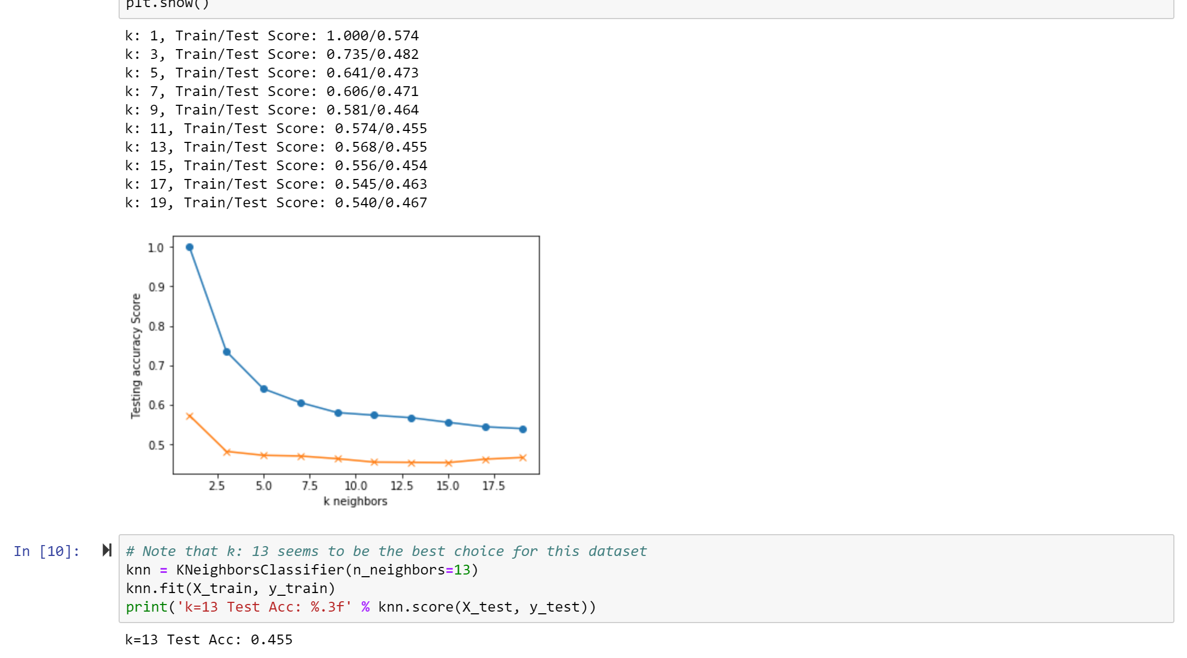
K Nearest Neighbors
Analysis
1
2
3

Slide 7
Regression

Slide 8
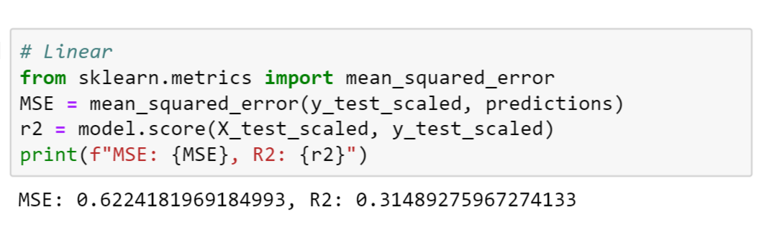
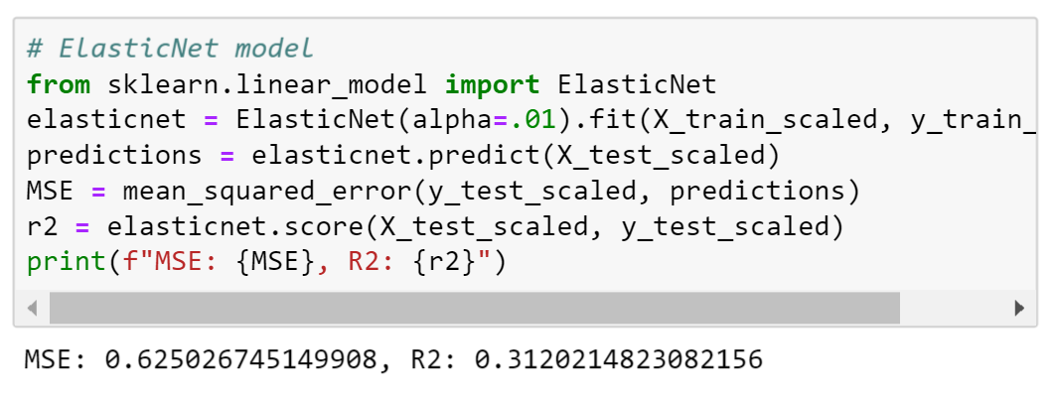
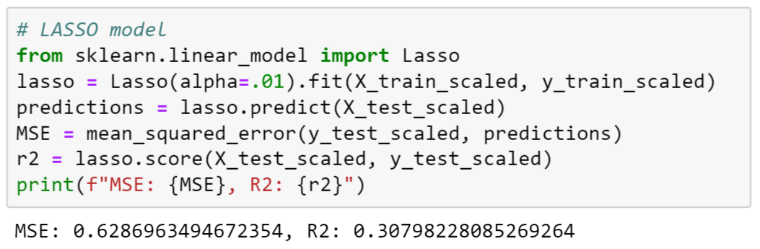
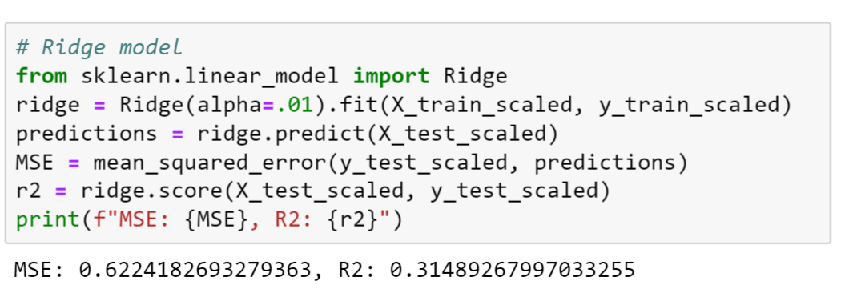
Regression and Measurements

Slide 9
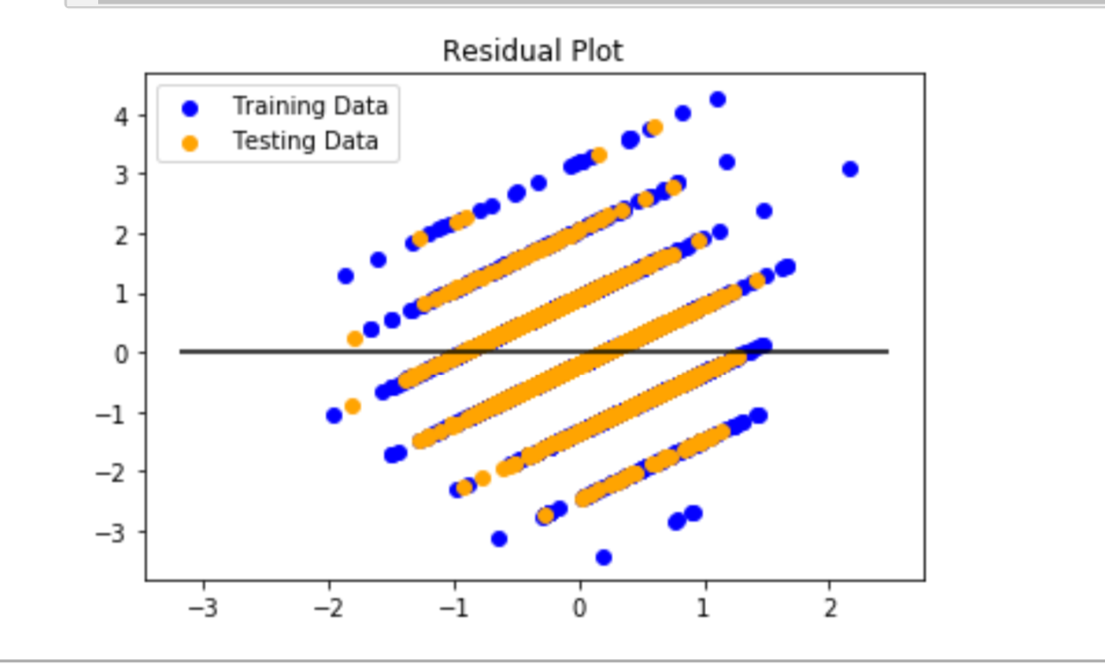
Analysis
1
2
3

